Slide 1

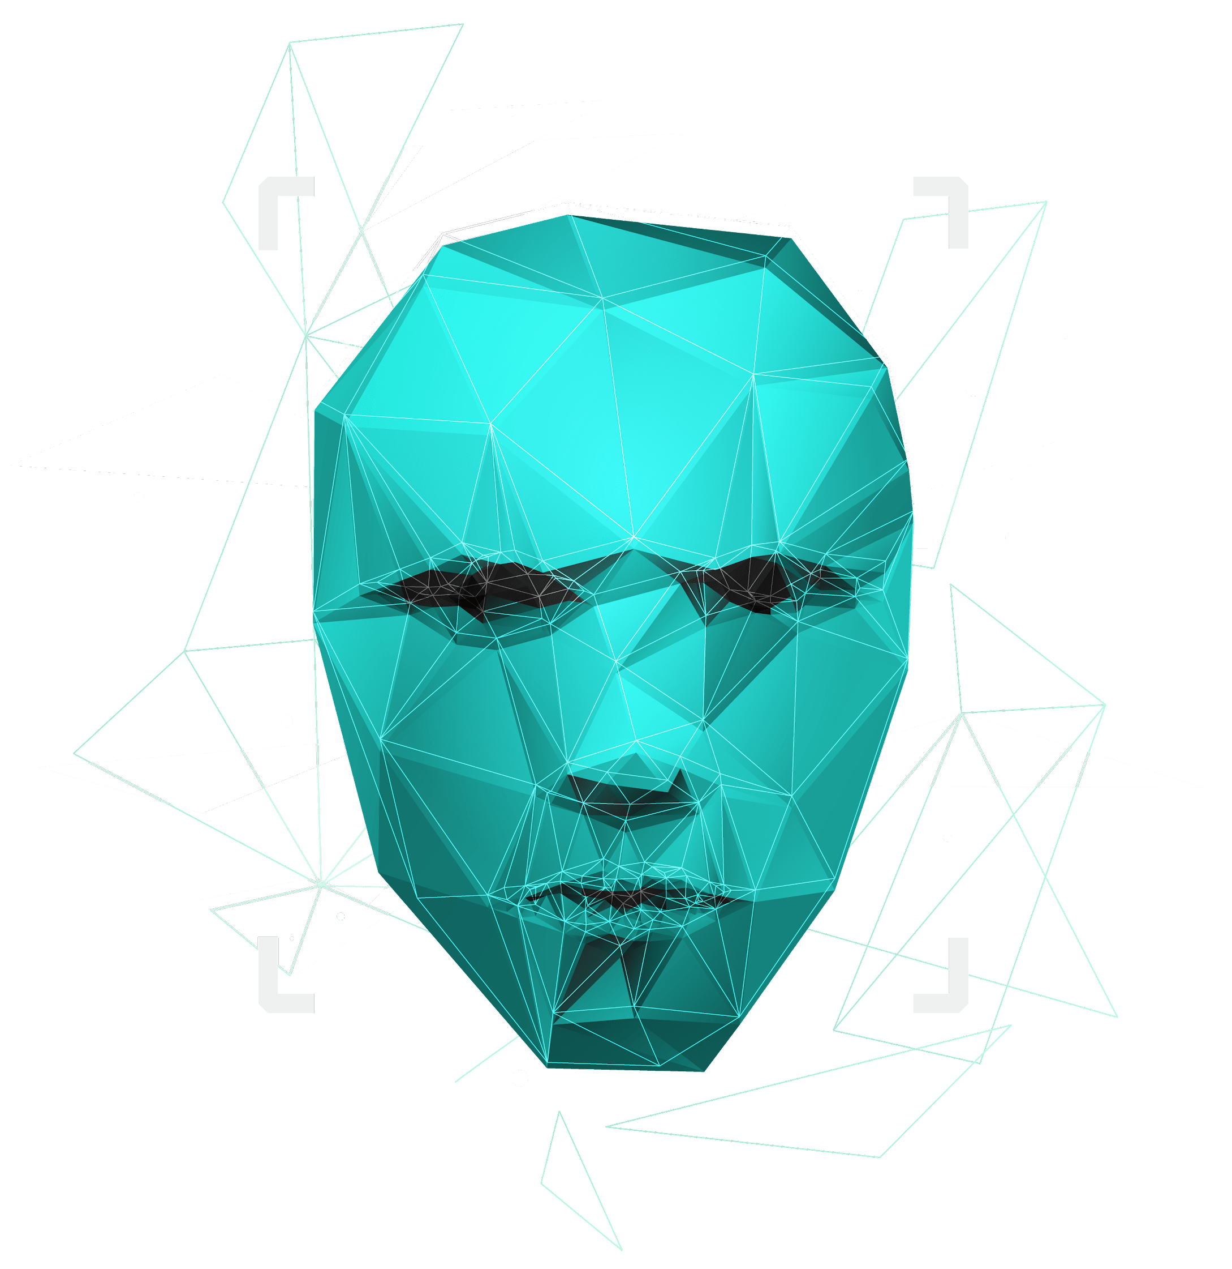
MULTI-PERSON POSE DETECTION
Presented By:
2010030481 - Tejaswini
2010030521 - Eshika
2010030007 -Yashwanth
2010030532 –Sai kamal

Slide 2

TABLE OF CONTENT
1 | 2 | 3 | 4 | 5
Project area | Literature Survey | Problem Statement | Conclusion | Suggestions

Slide 3

Computer Vision: Computer vision is a field of artificial intelligence that trains computers to interpret and understand the visual world. Using digital images from cameras and videos and deep learning models, machines can accurately identify and classify objects and they react to what they see.
Project Area:
Computer vision
Pose-estimation

Slide 4
Position estimation is a technique used in computer vision to track a person or object's movements. Usually, this is done by locating key points for the given objects. Through the comparison of these key points, we can develop insights into diverse movements and postures. Position estimation plays a critical role in augmented reality, animation, games, and robotic
Pose Estimation

Slide 5
LITERATURE SURVEY

Slide 6
S.NO | TITLE | Authors | Date | Publisher | Techniques | Datasets | Pros
1 | HPRNet: Hierarchical Point Regression for Whole-Body Human Pose Estimation | Nermin Samet, Emre Akbas | 8 june 2021 | Department of Computer Engineering METU | HPRNet as a bottom-up, one-stage method for whole-body keypoint detection. | COCO, COCO-WholeBody | The run time analysis of HPRNet shows that HPRNet runs in constant time, independently of the number of persons in an image.
2. | Mask R-CNN | Kaiming He Georgia Gkioxari Piotr Dollar Ross Girshick | 24 Jan 2018 | Facebook AI Research (FAIR) | R-CNN which is simple and effective | COCO, COCO-WholeBody | It extends faster R-CNN by adding a branch for bounding box recognition. It efficiently detects objects in an image while simultaneously generating a high-quality segmentation mask for each instance
3 | RMPE: Regional Multi-Person Pose Estimation | Hao-Shu Fang, Shu Qin Xie, Yu-Wing Tai, Cewu Lu | 2017 | Shanghai Jiao Tong University, China Tencent YouTu | Our RMPE framework consists of three novel components: symmetric STN with parallel SPPE, parametric pose NMS, and pose-guided proposals generator (PGPG). | COCO, MPII, UAV – Human, OCHuman | • The PGPG algorithm greatly increases the argumentation of training data by identifying the conditional distribution of bounding box proposals on a given human pose. • In NMS, the parametric pose property can be used to reduce redundant detections. Cons - SPPE cannot handle poses that are rarely occurred The erroneous pose is detected when an object looks very similar to a human which can fool both human detector and SPPE

Slide 7
S.NO | TITLE | Authors | Date | Publisher | Techniques | Datasets | Pros
4 | DeeperCut: A Deeper, Stronger, and Faster Multi-Person Pose Estimation Model | Eldar Insafutdinov, Leonid Pishchulin, Bjoern Andres, Mykhaylo Andriluka, and Bernt Schiele | 10 may 2016 | Max Planck Institute for Informatics, Germany, Stanford University, USA | It tackles the problem of vanishing gradients by passing the state through identity layers and modeling residual functions. | MPII , LSP, MPII Human pose | The proposed approach correctly resolves cases where only subsets of a person's body parts are visible in the image.
5. | OmniPose: A Multi-Scale Framework for Multi-Person Pose Estimation | Bruno Artacho, Andreas Savakis | 18th march 2021 | Rochester Institute of Technology Rochester, NY | 1. OmniPose architecture leverages multi-scale feature representations that increase the effectiveness of backbone feature extractors, without the need for post-processing. 2. OmniPose incorporates contextual information across scales and joint localization with Gaussian heatmap modulation at the multi-scale feature extractor to estimate human pose with state-of-the-art accuracy. | COCO, MPII,LSP | . Omnipose with an improved HRNet(High-resolution network backbone and waterfall module, is a robust and efficient architecture for multi-person pose estimation that achieves state-of-the-art results.

Slide 8
Semi-supervised human pose estimation aims to leverage the unlabelled data along with labeled data to improve the model performance.
PROBLEM STATEMENT

Slide 9
conclusion
By going through these various research papers, we got to know a lot about different techniques and dataset's used by some of the best researchers around the world
Therefore, we want to explore the topic further and add more features to our project, so that we can achieve the best result with the best-trained model at the end.

Slide 10
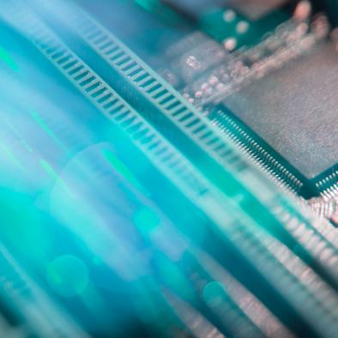
THANK YOU
THANK YOU

